Slide 1
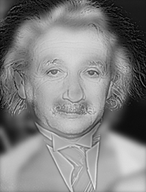
CSC 589 Introduction to Computer Vision Lecture 2 linear filtering
Instructor: Bei Xiao
Monday, September 11th

Slide 2
Announcement
First homework: Image Processing with Numpy/Scipy.
Go to evening recitation with TA (Wenyan Bi).
Due, Monday, September 18th.

Slide 3
Teaching Assistant
Wenyan Bi, PhD student
Email: wb1918a@american.edu
Office hours:
Recitation this week:

Slide 4
Today’s class
What is an image?
Point Process
Neighborhood operation
Convolution

Slide 5
Choices of Python Image libraries
Level 1 (basic): Numpy, treating image as matrix
Level 2 (Scipy): an image I/O (scipy.misc.imread), scipy.ndimage package that has convolution, filters, etc.
Level 3 (sckit-image): equivalent to MATLAB image processing toolbox, but better. Many built-in stuff, so not suitable for conceptual learning in the beginning.
High-level (OpenCV): it is not suitable for teaching but suitable for development. Very different from actual Python. We might use it for some projects later in the course.

Slide 6
Choices of Python libraries
Level 1 (basic): Numpy, treating image as matrix
Level 2 (Scipy): an image I/O (scipy.misc.imread), scipy.ndimage package
Level 3 (sckit-image): equivalent to MATLAB image processing toolbox, but better. We will use it when we need to.
High-level (OpenCV): it is not suitable for teaching but suitable for development. We might use it for some projects later in the course.
The higher level library you use, the less control you have!

Slide 7
To start, we will use the basic level libraries!
Level 1 (basic): Numpy, basic numerical Python, treating image as matrix
Level 2 (Scipy): an image I/O (scipy.misc.imread), scipy.ndimage package
We will write our own functions!

Slide 8
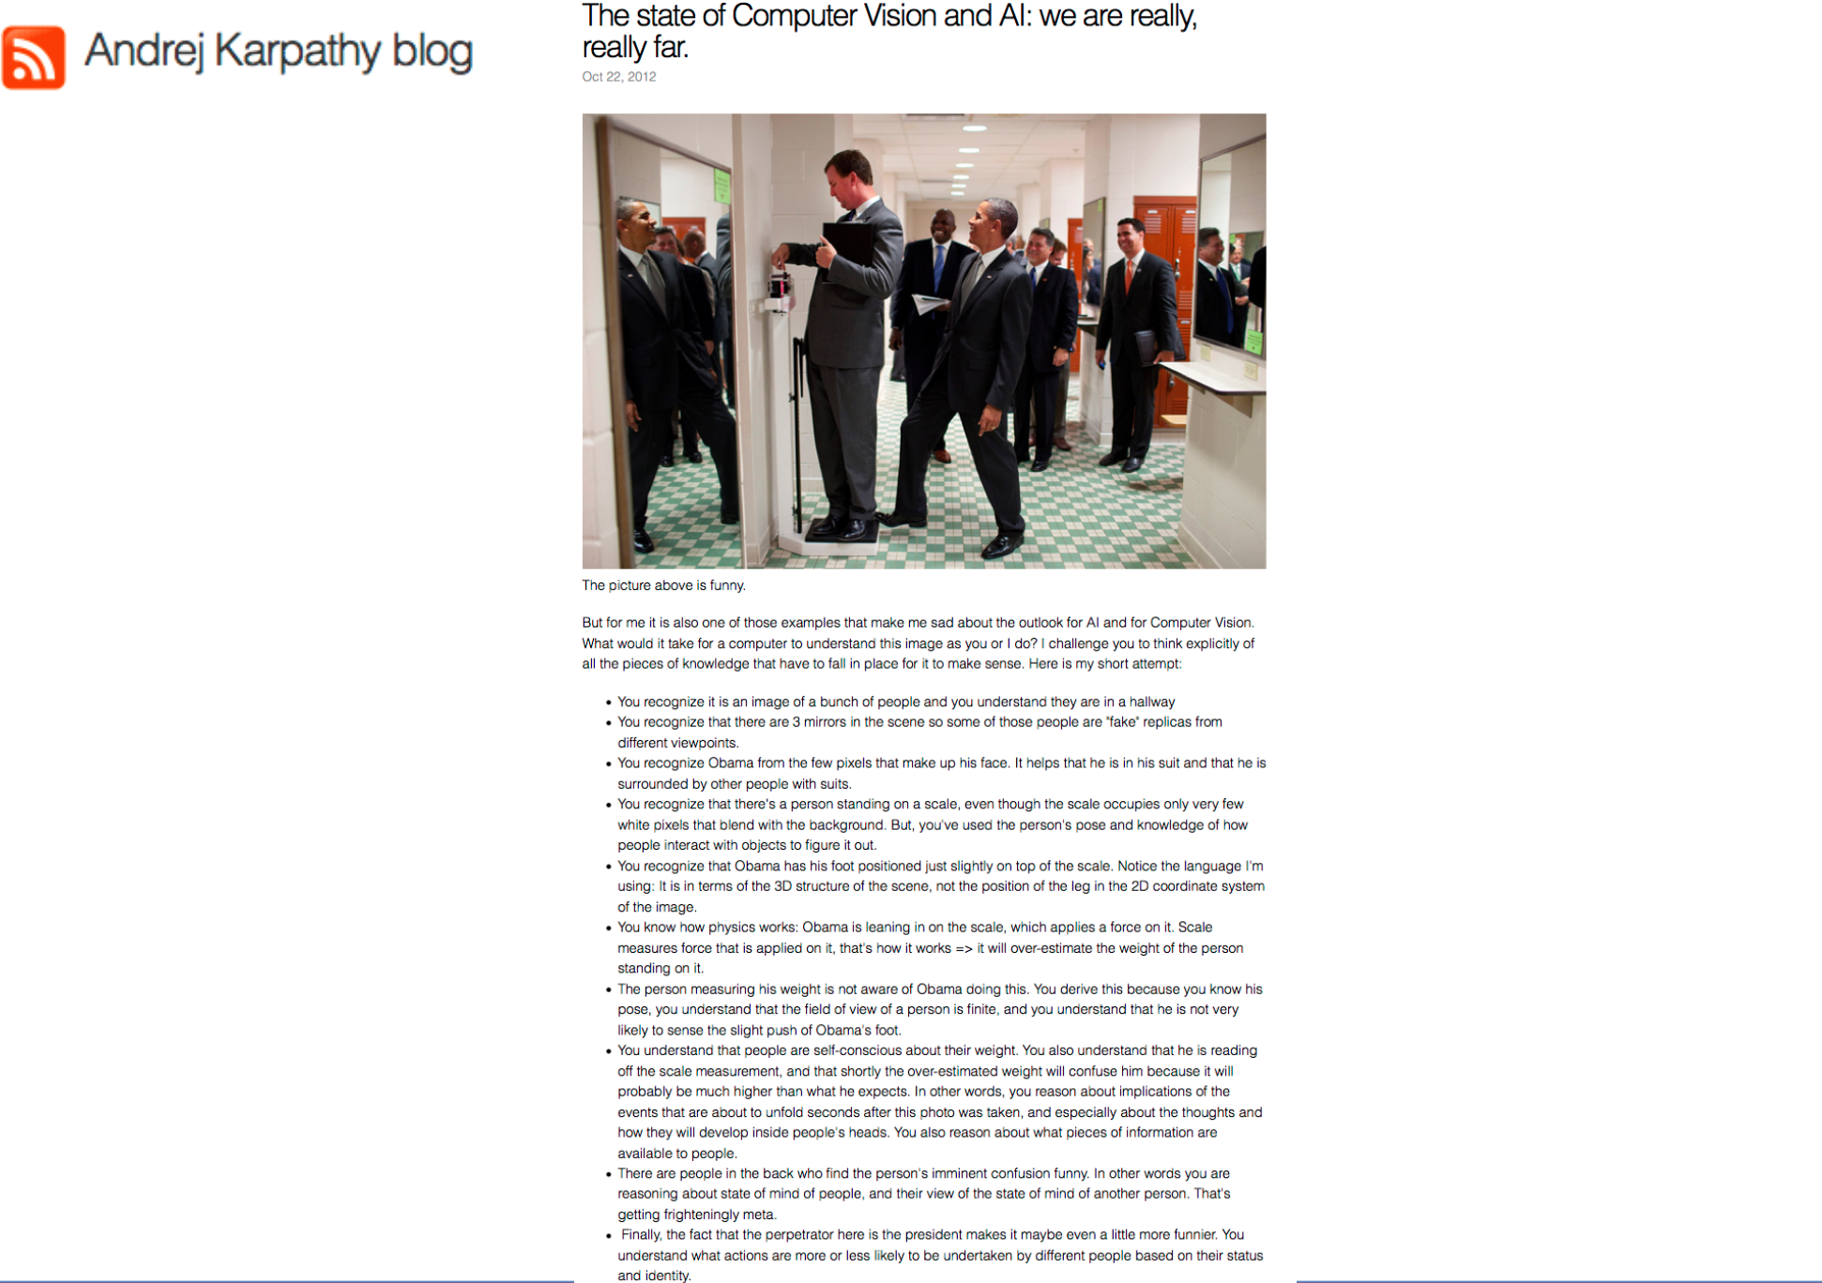

Slide 11
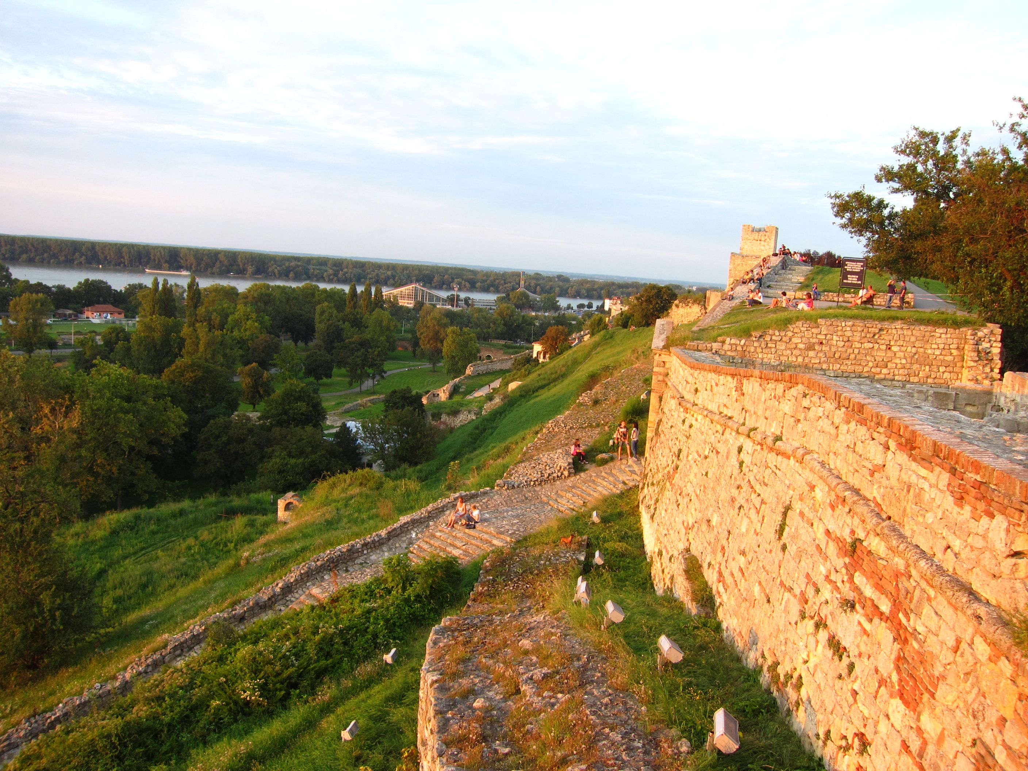
What is an image?

Slide 12
A useful tutorial
Computer vision for dummies

Slide 13


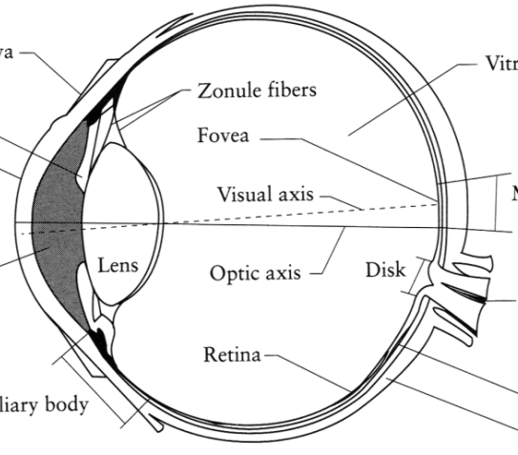
What is an image?
Digital Camera
We’ll focus on these in this class
(More on this process later)
The Eye
Source: A. Efros

Slide 14
What is an image?
A grid (matrix) of intensity values
(common to use one byte per value: 0 = black, 255 = white)
255 | 255 | 255 | 255 | 255 | 255 | 255 | 255 | 255 | 255 | 255 | 255
255 | 255 | 255 | 255 | 255 | 255 | 255 | 255 | 255 | 255 | 255 | 255
255 | 255 | 255 | 20 | 0 | 255 | 255 | 255 | 255 | 255 | 255 | 255
255 | 255 | 255 | 75 | 75 | 75 | 255 | 255 | 255 | 255 | 255 | 255
255 | 255 | 75 | 95 | 95 | 75 | 255 | 255 | 255 | 255 | 255 | 255
255 | 255 | 96 | 127 | 145 | 175 | 255 | 255 | 255 | 255 | 255 | 255
255 | 255 | 127 | 145 | 175 | 175 | 175 | 255 | 255 | 255 | 255 | 255
255 | 255 | 127 | 145 | 200 | 200 | 175 | 175 | 95 | 255 | 255 | 255
255 | 255 | 127 | 145 | 200 | 200 | 175 | 175 | 95 | 47 | 255 | 255
255 | 255 | 127 | 145 | 145 | 175 | 127 | 127 | 95 | 47 | 255 | 255
255 | 255 | 74 | 127 | 127 | 127 | 95 | 95 | 95 | 47 | 255 | 255
255 | 255 | 255 | 74 | 74 | 74 | 74 | 74 | 74 | 255 | 255 | 255
255 | 255 | 255 | 255 | 255 | 255 | 255 | 255 | 255 | 255 | 255 | 255
255 | 255 | 255 | 255 | 255 | 255 | 255 | 255 | 255 | 255 | 255 | 255
=

Slide 15
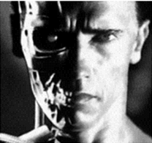
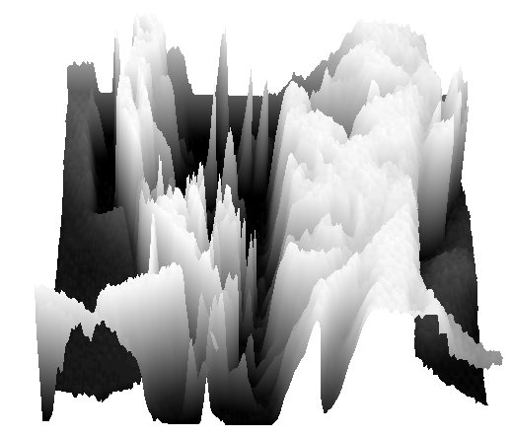
What is an image?
We can think of a (grayscale) image as a function, f, from R² to R:
f (x,y) gives the intensity at position (x,y)
A digital image is a discrete (sampled, quantized) version of this function
f (x, y)
x
y
Slide credit: James Hays

Slide 16
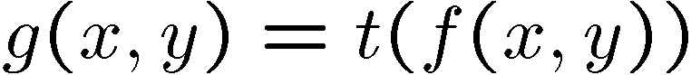
Image Processing
Define a new image g in terms of an existing image f
We can transform either the domain or the range of f
Range transformation:
What kinds of operations can this perform?

Slide 17
Point Operations
Notes:
17

Slide 18
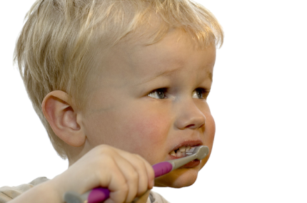
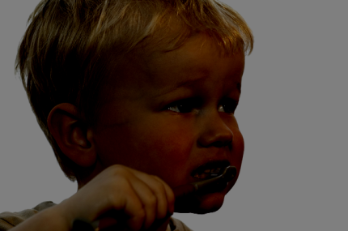


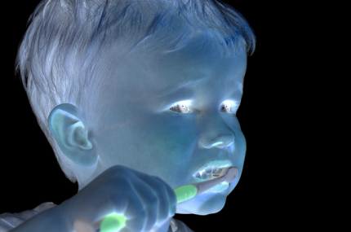
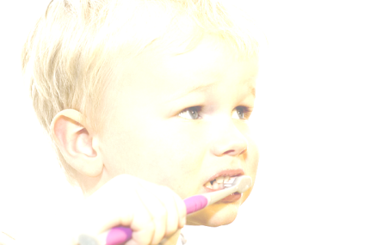

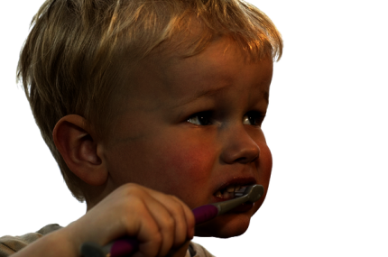
Point Processing
Nonlinear Lower Contrast
Original
Darken
Lower Contrast
Nonlinear Raise Contrast
Invert
Lighten
Raise Contrast
Slide source: S. Narasimhan
Notes:
18

Slide 19
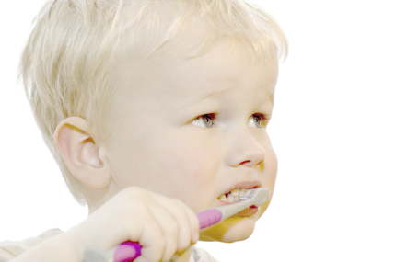
Point Processing
Nonlinear Lower Contrast
Original
Darken
Lower Contrast
x
x - 128
x / 2
((x / 255.0) ^ 0.33) * 255.0
Nonlinear Raise Contrast
Invert
Lighten
Raise Contrast
255 - x
x + 128
x * 2
((x / 255.0) ^2) * 255.0
Slide source: S. Narasimhan
Notes:
Point Processing demos
19

Slide 20
Neighborhood Operations
Slide source: S. Narasimhan
Notes:
20

Slide 21
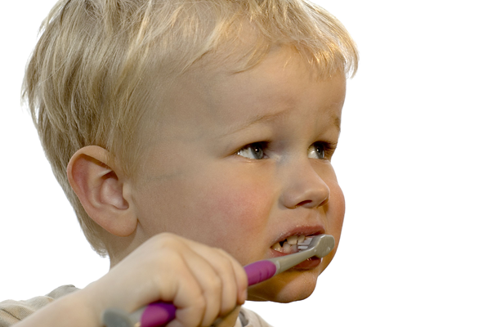
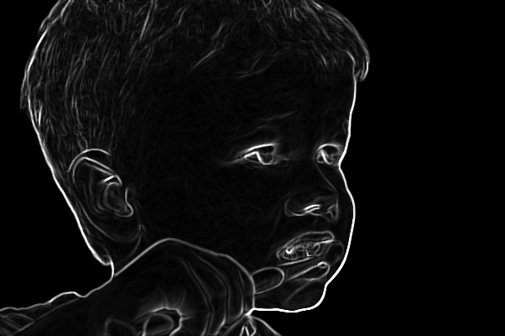
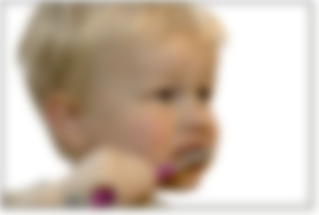
Neighborhood operations
Image
Edge detection
Blur
Slide source: S. Narasimhan
Notes:
21

Slide 22
Neighborhood operations
Image
Edge detection
Blur
Slide source: S. Narasimhan
Notes:
22

Slide 23


3×3 Neighborhood

Slide 24

5×5 Neighborhood

Slide 25

7×7 Neighborhood

Slide 26
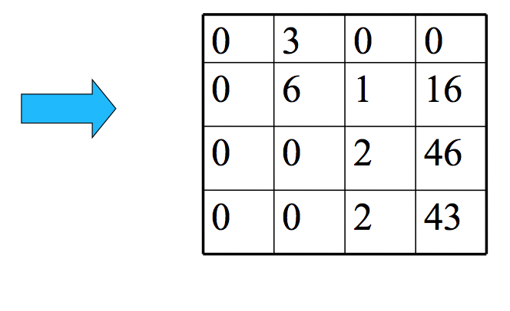
Let’s represent this more generally
Slide source: Matthew Tappen

Slide 27
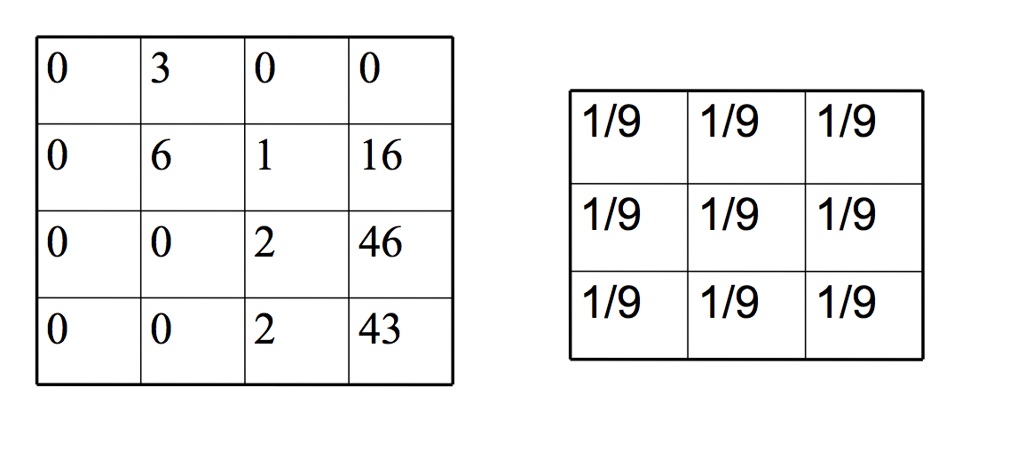
Let’s represent this more generally
Normalized box filter (3×3)
Slide source: Matthew Tappen

Slide 28
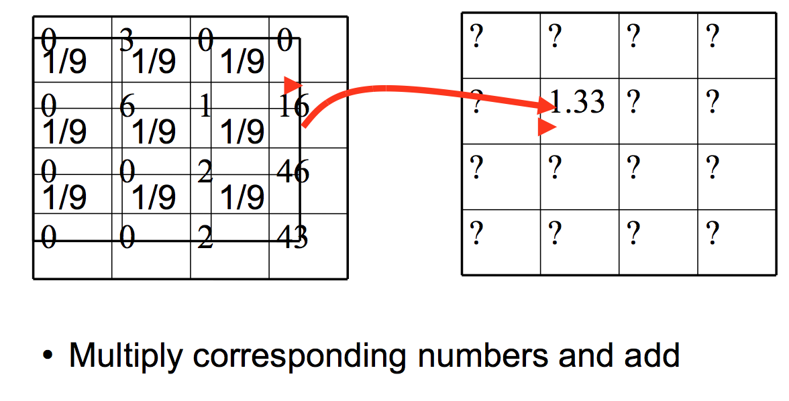
Let’s represent this more generally
Slide source: Matthew Tappen

Slide 29
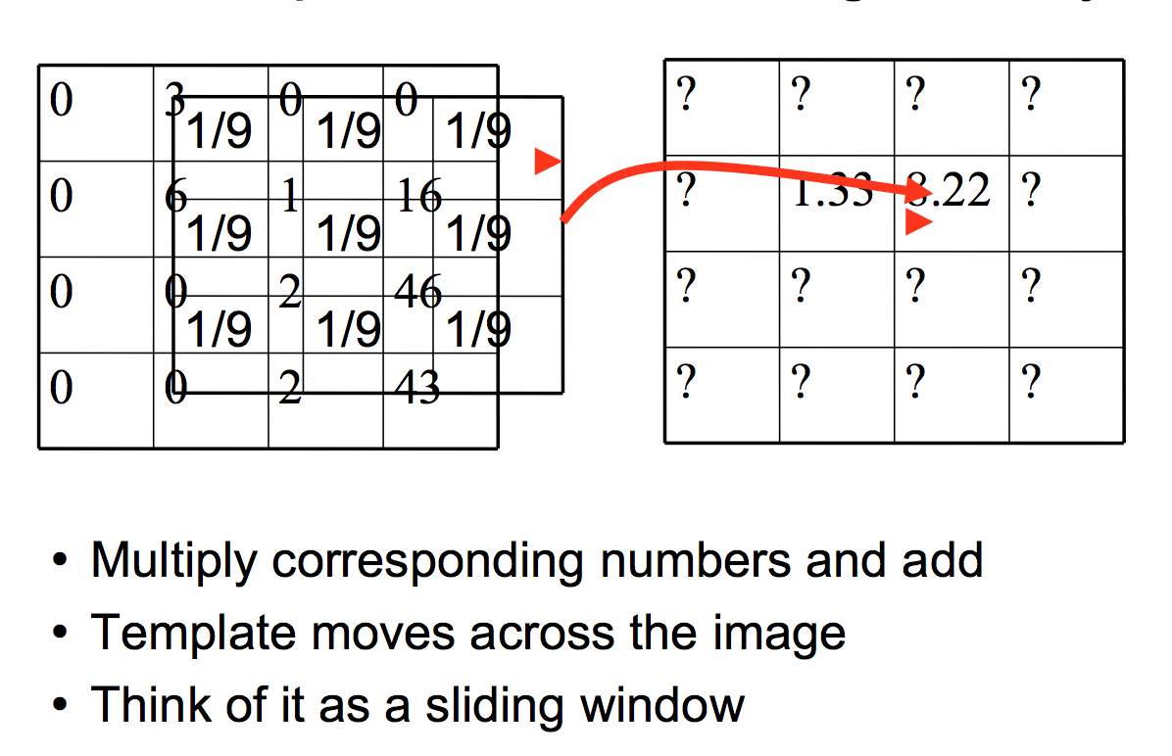
Let’s represent this more generally
Slide source: Matthew Tappen

Slide 30
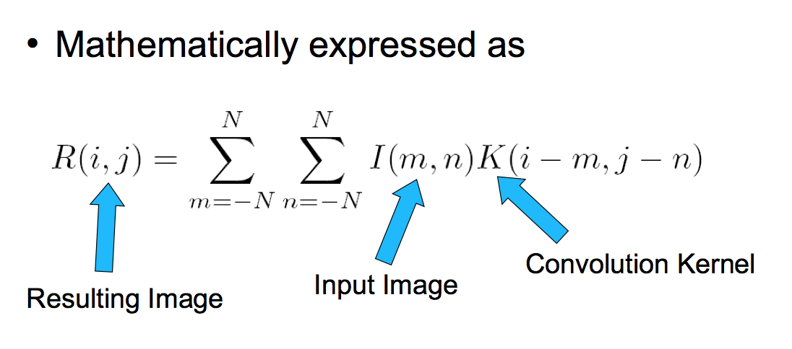
This is called convolution
https://en.wikipedia.org/wiki/Convolution
https://dsp.stackexchange.com/questions/2654/what-is-the-difference-between-convolution-and-cross-correlation
Slide source: Matthew Tappen

Slide 31
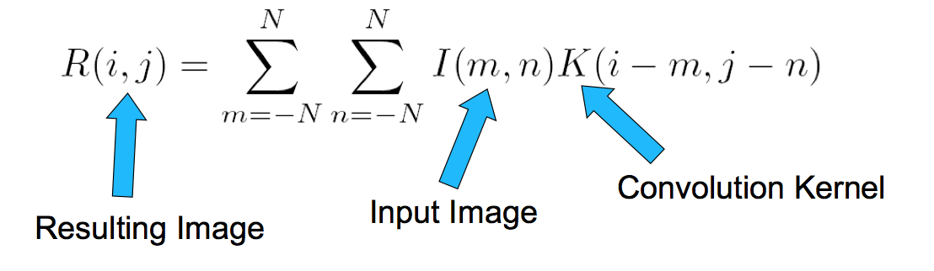
Notation
Also denoted as
R = I * K
We “convolve” I with K
-Not convolute!
Slide source: Matthew Tappen

Slide 32
Filtering vs. Convolution
2d filtering
h=filter2(g,f); or h=imfilter(f,g);
2d convolution (must flip kernel)
h=conv2(g,f);
We use Filter and Convolution interchangeable when the image is SYMMETRIC.

Slide 33
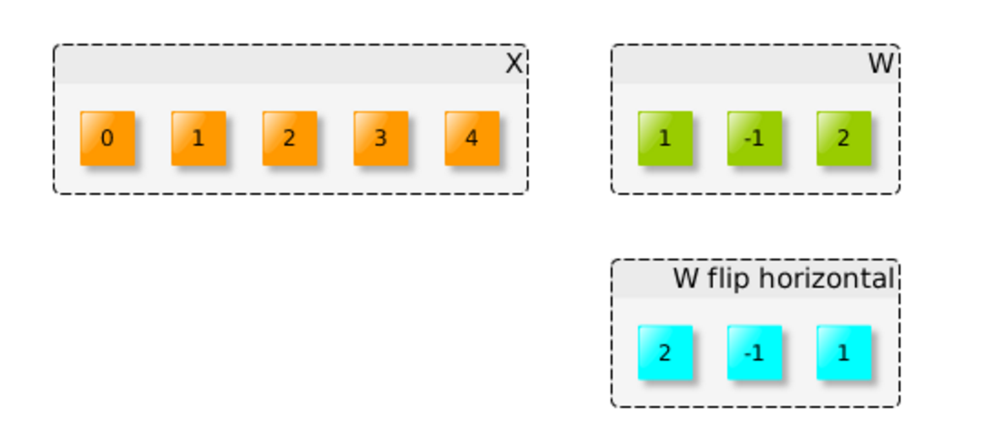
Short tutorial on convolution

Slide 34
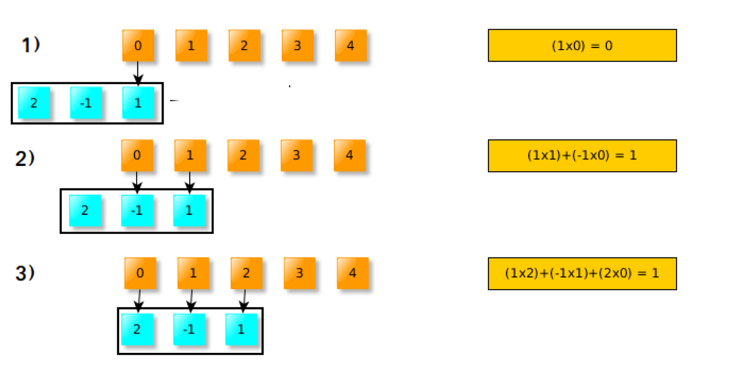
Doing by hand

Slide 35
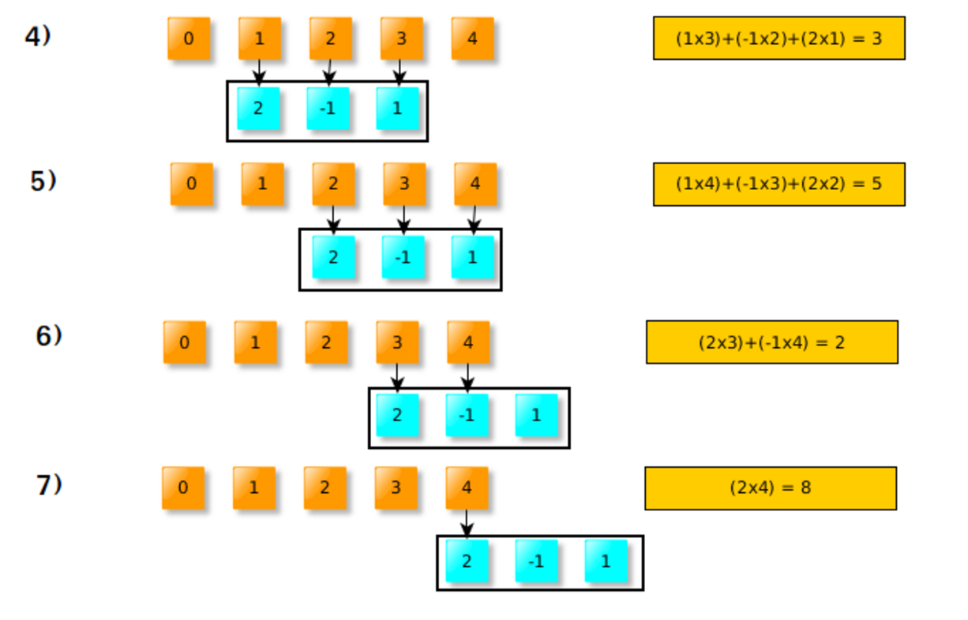
Doing by hand

Slide 36
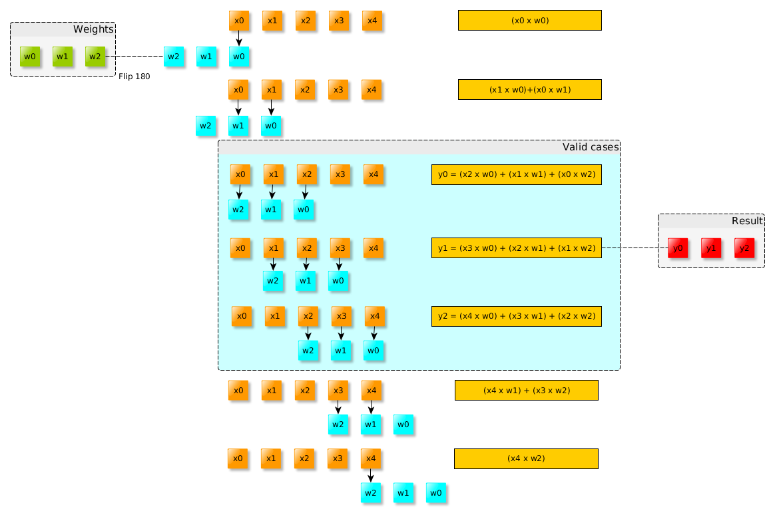
Transform to computation

Slide 37
In Python
import numpy as np
x = np.array([0,1,2,3,4])
w = np.array([1,-1,2])
res = np.convolve(x,w, ‘valid’)
print res

Slide 38
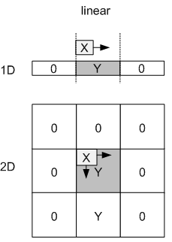
Input Padding

Slide 39
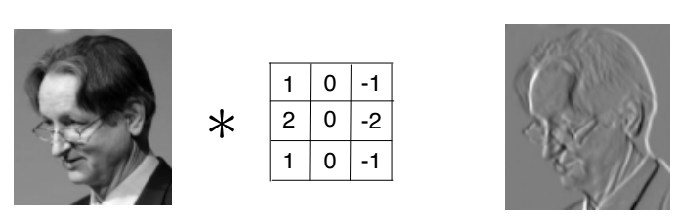
2D convolution

Slide 40
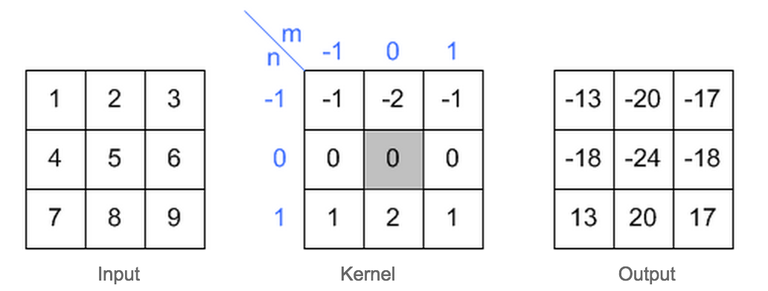
Let’s take out paper and pen
What is the result of the following convolution?

Slide 41
Let’s take out paper and pen
What is the result of the following convolution?

Slide 42
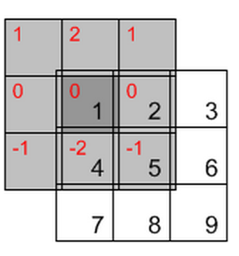
Let’s take out a paper and a pen
What is the result of the following convolution?
1*0 + 2*0 + 1*0+
0*0 + 1*0 + 2*0+
(-1)*0 + (-2)*4 +(-1)*5 = -13

Slide 43
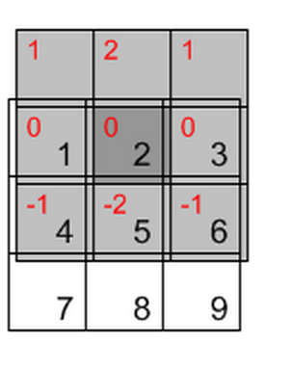
Let’s take out a paper and a pen
What is the result of the following convolution?

Slide 44



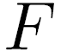
Convolution
Adapted from F. Durand

Slide 45
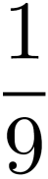
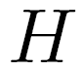
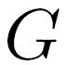
Mean filtering
0 | 0 | 0 | 0 | 0 | 0 | 0 | 0 | 0 | 0
0 | 0 | 0 | 0 | 0 | 0 | 0 | 0 | 0 | 0
0 | 0 | 0 | 90 | 90 | 90 | 90 | 90 | 0 | 0
0 | 0 | 0 | 90 | 90 | 90 | 90 | 90 | 0 | 0
0 | 0 | 0 | 90 | 90 | 90 | 90 | 90 | 0 | 0
0 | 0 | 0 | 90 | 0 | 90 | 90 | 90 | 0 | 0
0 | 0 | 0 | 90 | 90 | 90 | 90 | 90 | 0 | 0
0 | 0 | 0 | 0 | 0 | 0 | 0 | 0 | 0 | 0
0 | 0 | 90 | 0 | 0 | 0 | 0 | 0 | 0 | 0
0 | 0 | 0 | 0 | 0 | 0 | 0 | 0 | 0 | 0
 | 0 | 10 | 20 | 30 | 30 | 30 | 20 | 10
 | 0 | 20 | 40 | 60 | 60 | 60 | 40 | 20
 | 0 | 30 | 60 | 90 | 90 | 90 | 60 | 30
 | 0 | 30 | 50 | 80 | 80 | 90 | 60 | 30
 | 0 | 30 | 50 | 80 | 80 | 90 | 60 | 30
 | 0 | 20 | 30 | 50 | 50 | 60 | 40 | 20
 | 10 | 20 | 30 | 30 | 30 | 30 | 20 | 10
 | 10 | 10 | 10 | 0 | 0 | 0 | 0 | 0
*
=
1 | 1 | 1
1 | 1 | 1
1 | 1 | 1

Slide 46
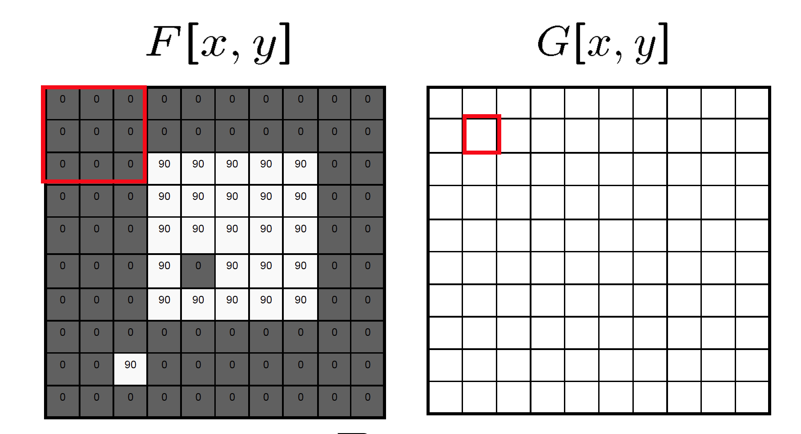
Mean filtering/Moving average

Slide 47
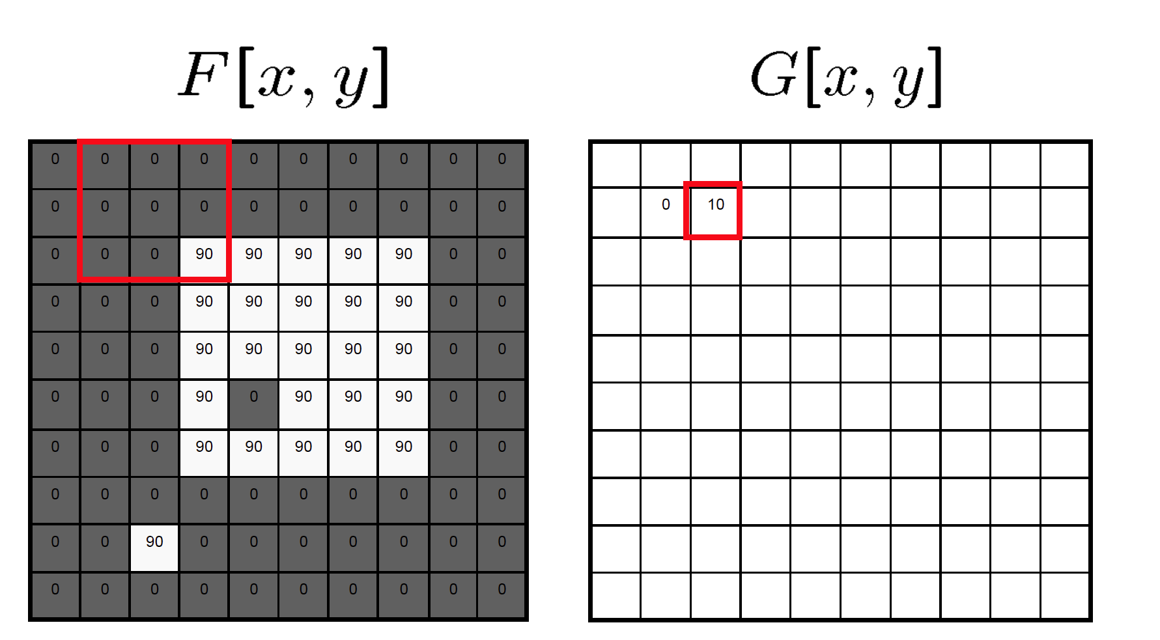
Mean filtering/Moving average

Slide 48

Mean filtering/Moving average

Slide 49
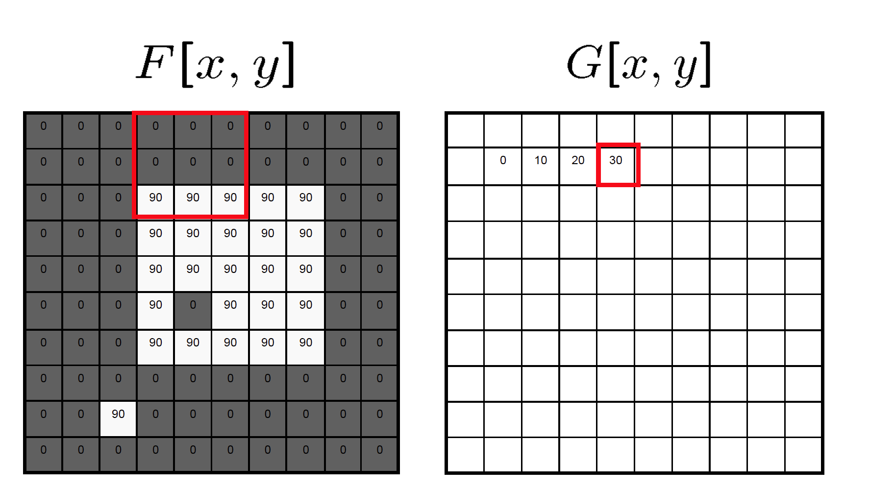
Mean filtering/Moving average

Slide 50
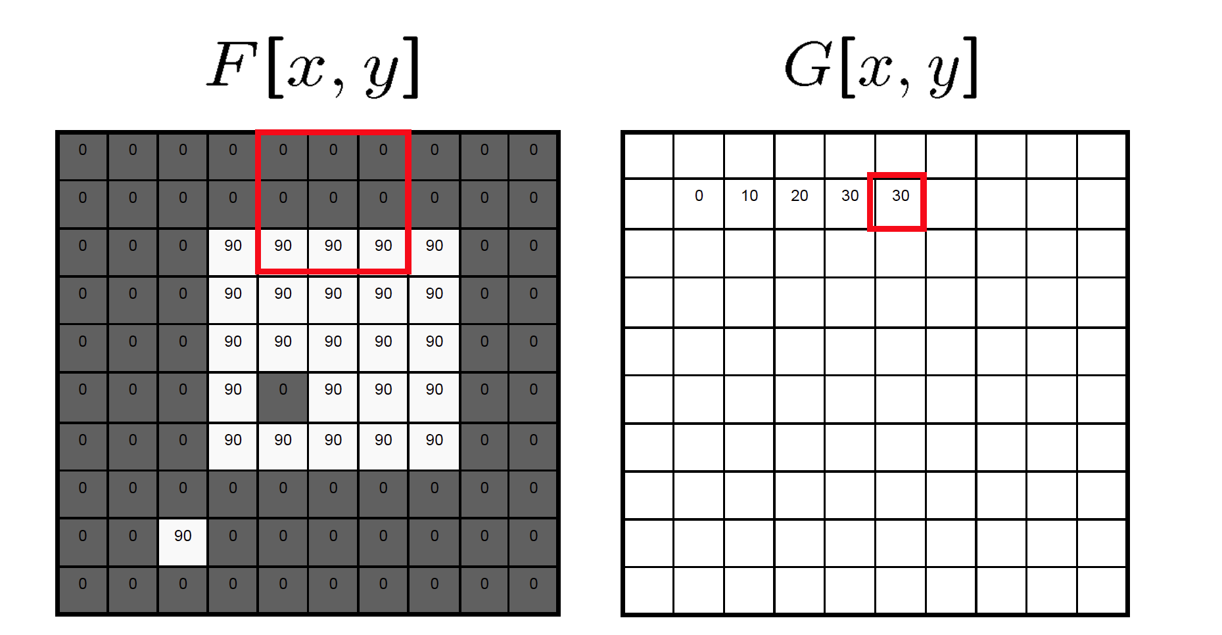
Mean filtering/Moving average

Slide 51
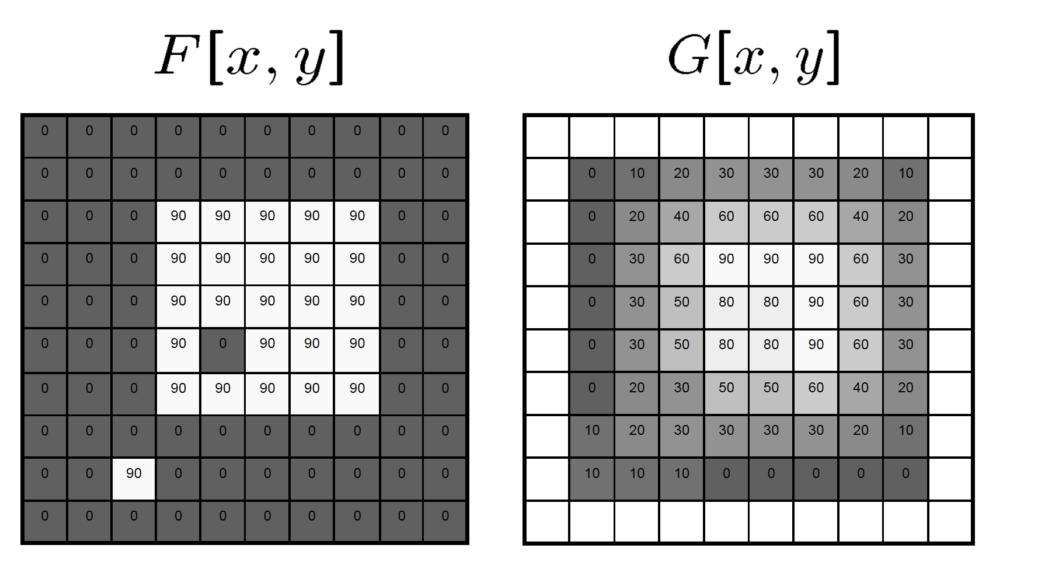
Mean filtering/Moving average

Slide 52
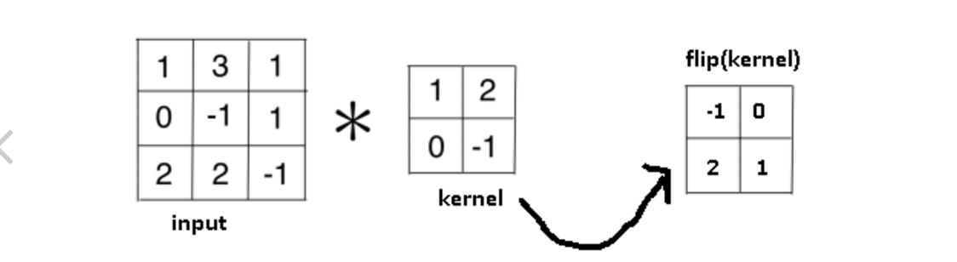
Let’s take out a paper and a pen

Slide 53
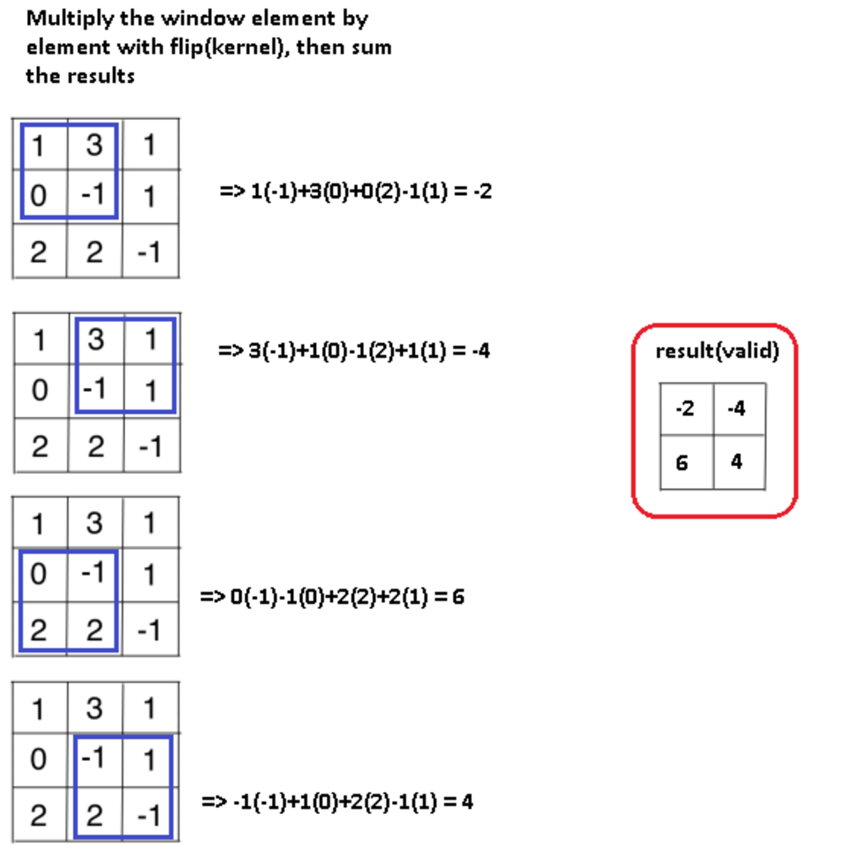
Let’s take out a paper and a pen

Slide 54
Check it with Python?
import numpy as np
from scipy import signal
# use np.array
# use signal.convolve2d

Slide 55
Rules of a image filter
It’s size has to be uneven, so that it has a center, for example, 3×3, 5×5, 7×7
It doesn’t have to, but the sum of all elements of the filter should be 1 if you want the result image to have the same brightness as the original
If the sum of the element of is larger than 1, the result will be a brighter image, if it is smaller than 1, the resulting image will be darker.

Slide 56
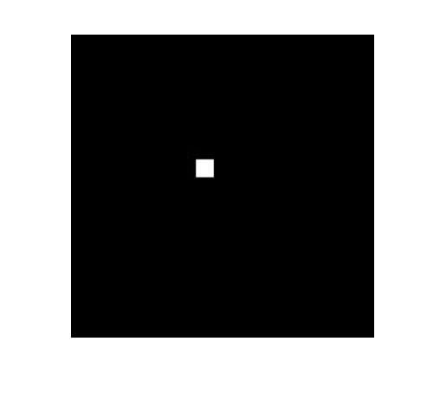
Predict the image
Slide source: Matthew Tappen

Slide 57
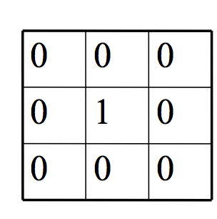
Predict the image
Slide source: Matthew Tappen

Slide 58
Predict the image
Slide source: Matthew Tappen

Slide 59
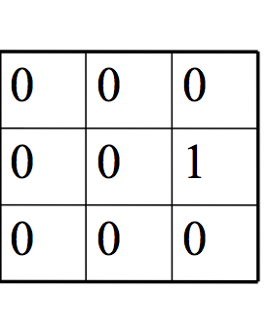
Predict the image
Slide source: Matthew Tappen

Slide 60
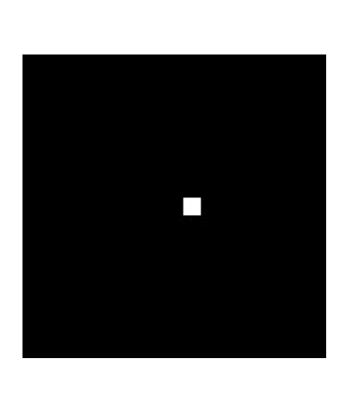
Predict the image
Slide source: Matthew Tappen

Slide 61
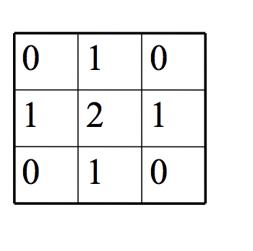
Predict the image
Slide source: Matthew Tappen

Slide 62
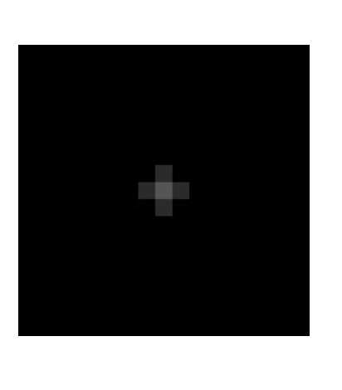
Predict the image
Should be brighter!
Slide source: Matthew Tappen

Slide 63
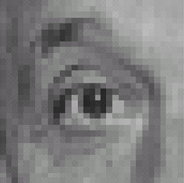
Practice with linear filters
*
0
0
0
=
0
1
0
0
0
0
Original
Filtered
(no change)
Source: D. Lowe

Slide 64
Linear filters: examples
*
0
0
0
=
1
0
0
0
0
0
Original
Shifted left
By 1 pixel
Source: D. Lowe

Slide 65
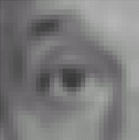

Linear filters: examples
*
1
1
1
=
1
1
1
1
1
1
Original
Blur (with a mean filter)
Source: D. Lowe

Slide 66




Linear filters: examples
*
0
0
0
-
1
1
1
=
0
2
0
1
1
1
0
0
0
1
1
1
Sharpening filter (accentuates edges)
Original
Source: D. Lowe

Slide 67
Take home exercises
Find out why the sharper filter works by manually
convolve a 5x5 matrix with the kernel.
Using Python to test all the linear filter operations on images.

Slide 68

Sharpening
Source: D. Lowe

Slide 69


Other filters
1
0
-1
2
0
-2
1
0
-1
Sobel
Vertical Edge
(absolute value)

Slide 70

Other filters
1
2
1
0
0
0
-1
-2
-1
Sobel
Horizontal Edge
(absolute value)
Notes:
Questions at this point?

Slide 71
Python image convolution demo
scipy.ndimage.filters.convolve, specifically
for images
scipy.signal.convolve2d, general 2D convolution
Notes:
Questions at this point?

Slide 72
Next class (Next Thursday)
Please sigh up for TA’s Tutorial on image processing with Python (Numpy, Scipy, Matplotlib)
More on image processing, contrast enhancement, image histograms, Gaussian Filter.
Take-home reading: Szeliski, Chapter 3.1-3.2

